Slide 1

VITA Lab
Building and opening instance segmentation
Vincent Naayem, MSc Robotics
Semester Project 10CTS
Notes:
Object detection + Semantic Segmentation

Slide 2
Content
Introduction
Related work
Approach
Experiment detail
Conclusion

Slide 3
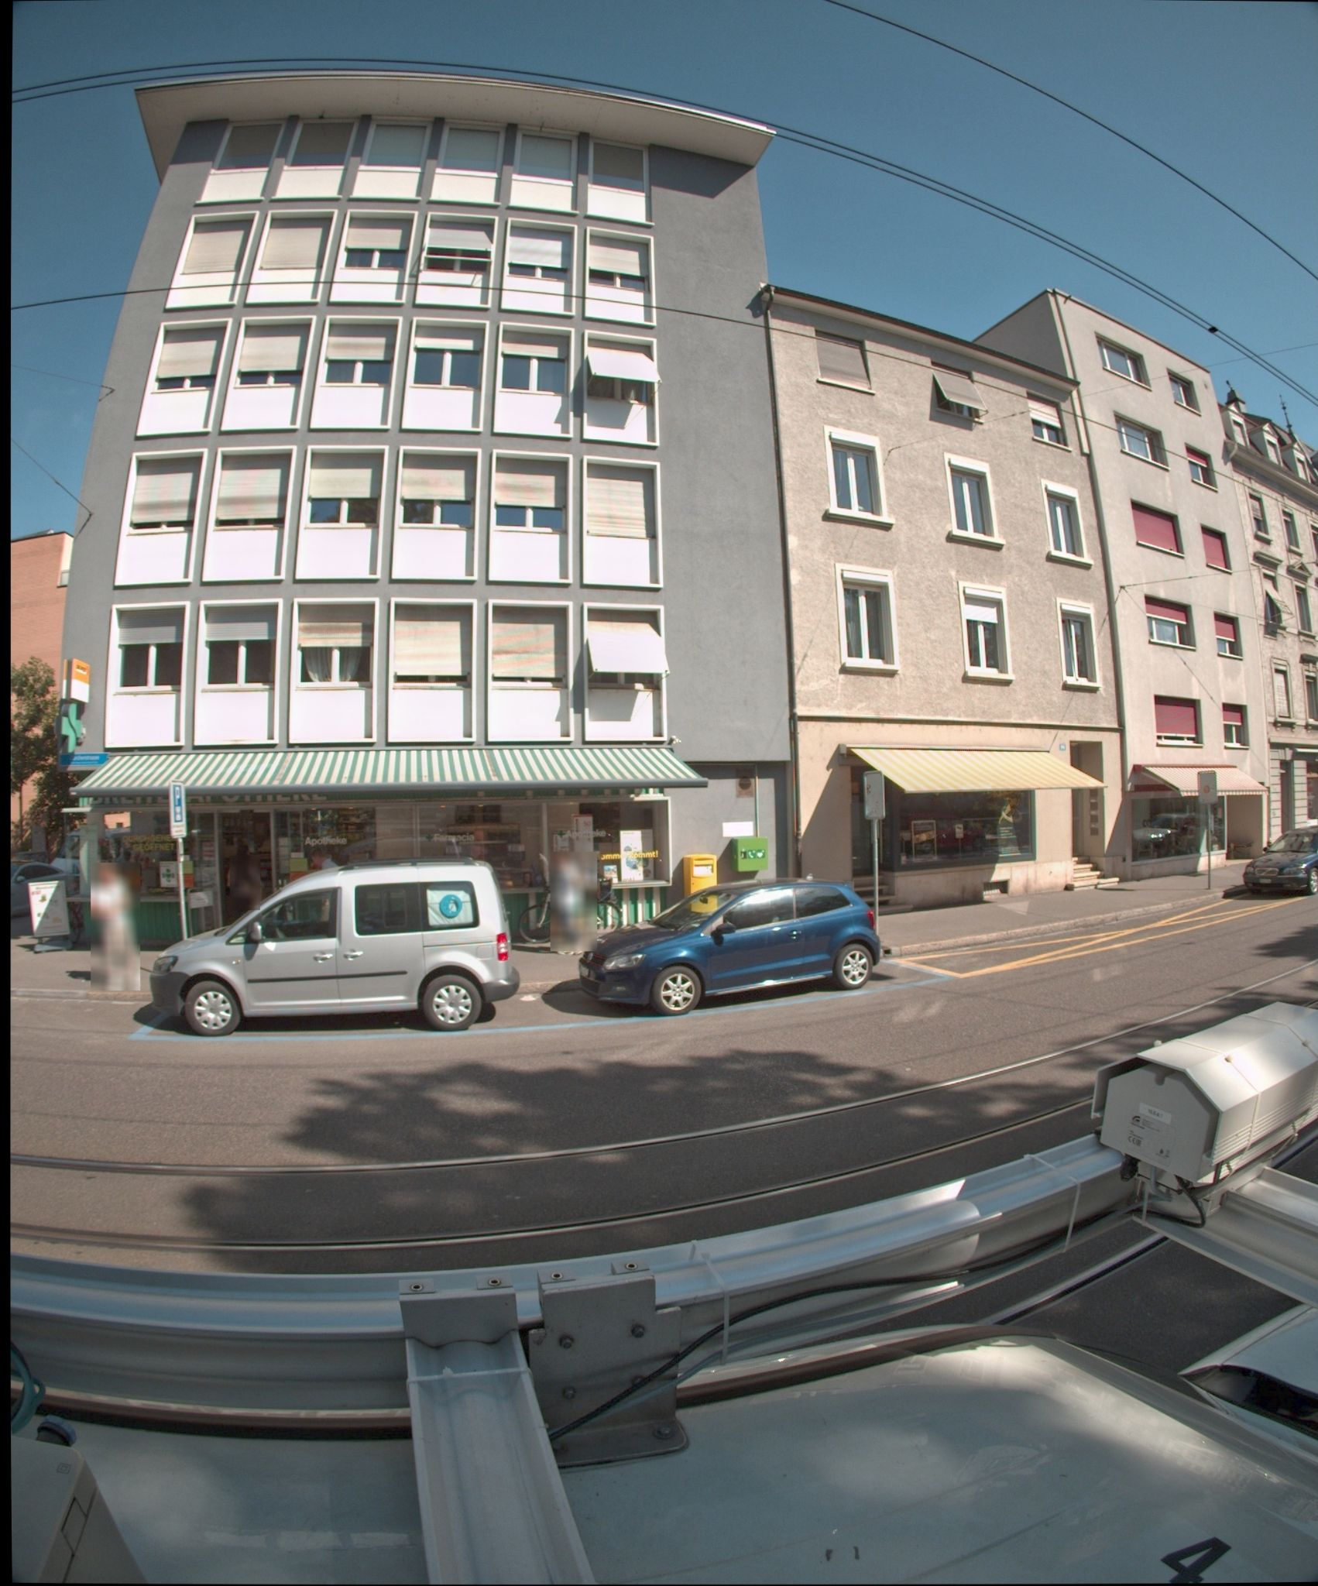
Problem Statement
Use image recognition and deep learning techniques to do several tasks on the building image dataset
Detect the building instances and openings (window and door)
Accurate detection and segmentation
Allows many applications
Count floors, estimate width and height
Building type detection
Matching same buildings’ instances
Minimize cost of annotations

Slide 4
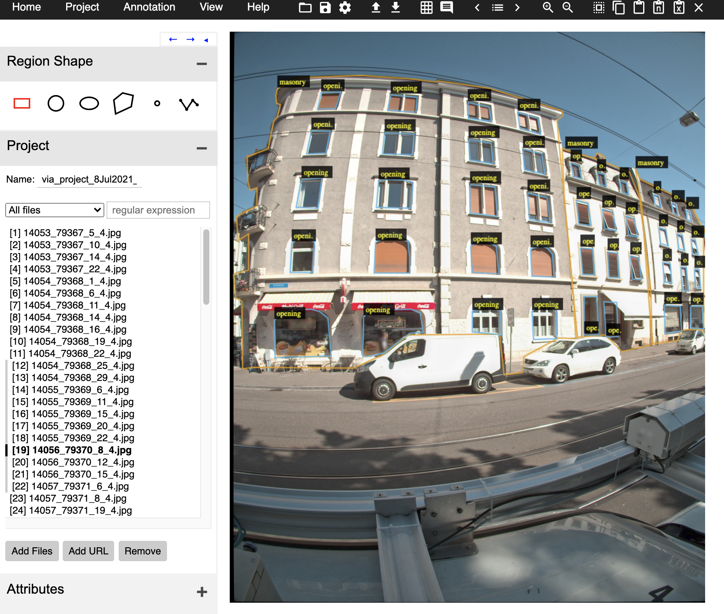
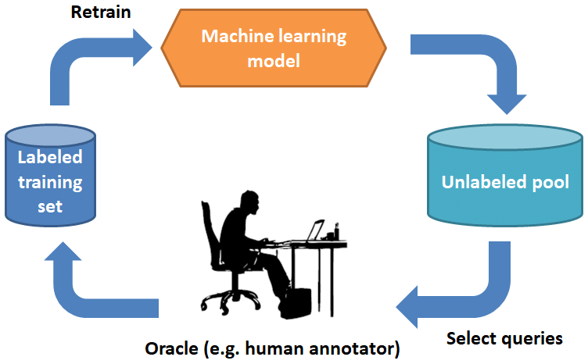
Our goal is to create an algorithm that sample the most informative images and uses self-annotations to minimize training costs

Slide 5
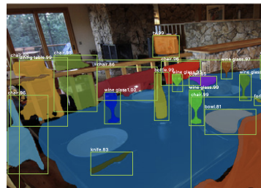
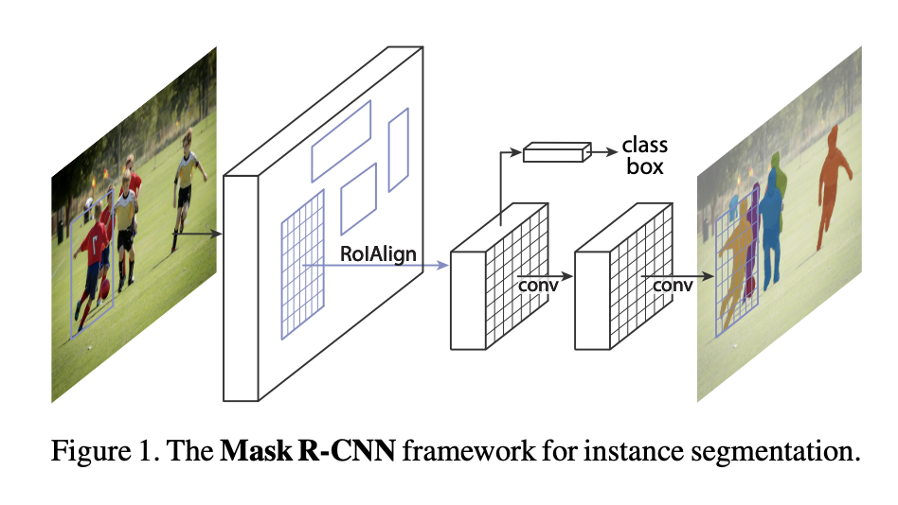
Mask RCNN
Facebook AI research group presented Mask R-CNN model. It is a state-of-art method for image instance segmentation.
Notes:
MaskR-CNN, a state-of-the-art method in the image instance segmentation. The segmentation is in parallel with the identification and localization tasks.

Slide 6
Approach
Model:
Images
Model:
Mask-RCNN
Building Instances and openings
Training: Active learning
Labeled data
Unlabeled raw data
Human labeling
Model:
Mask-RCNN
Predictive model
Data selection algorithm
Notes:
Deep learning and trhreshold

Slide 7
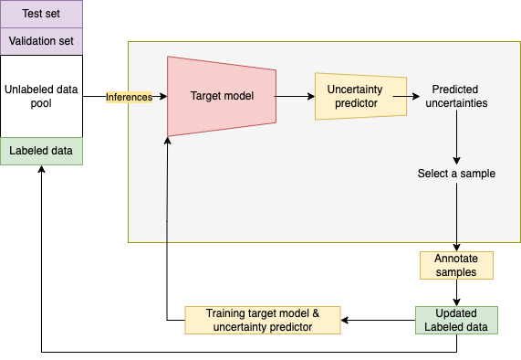
Active Learning: Uncertainty sampling
Uncertainty score from Detectron2
Prediction boxes’ confidence scores

Slide 8
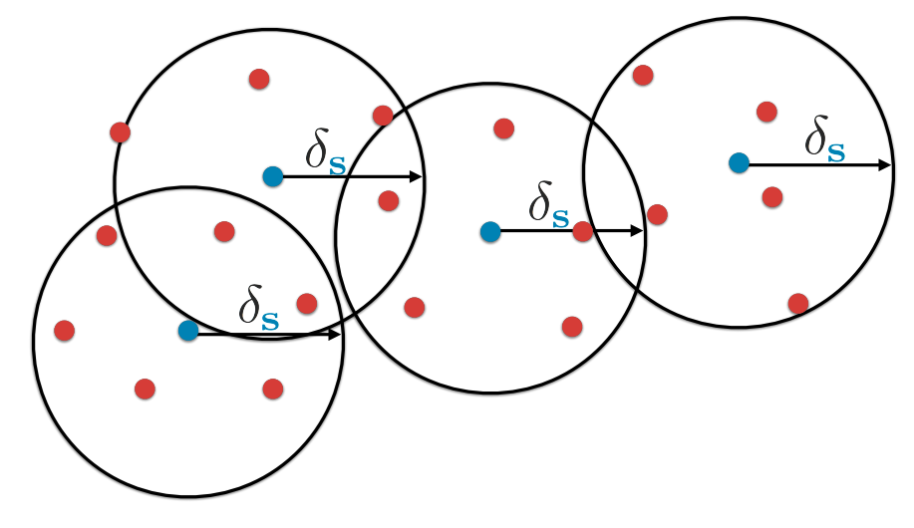
Active learning: diversity sampling
Images semantically distinct from each other
UMAP
K-center problem

Slide 9
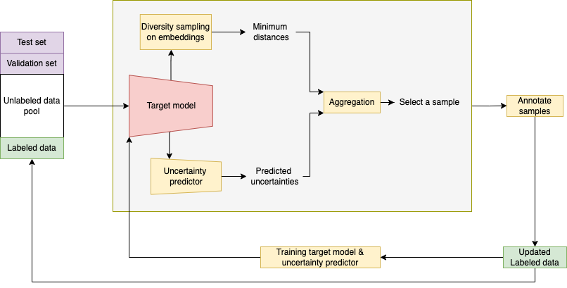
Active Learning: Confident Coreset
Combination of diversity and uncertainty sampling

Slide 10
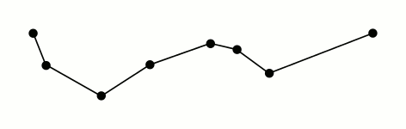
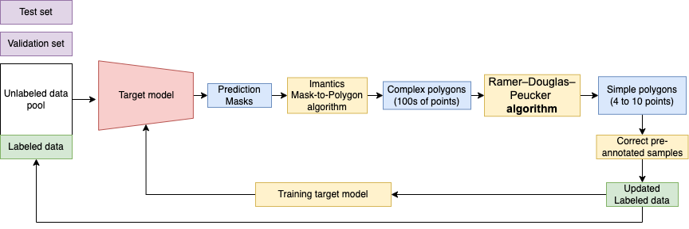
Self-Annotation
Some predictions are correct
Detectron’s predictions are masks
Convert masks to Polygon
Ramer-Douglas-Peucker algorithm

Slide 11
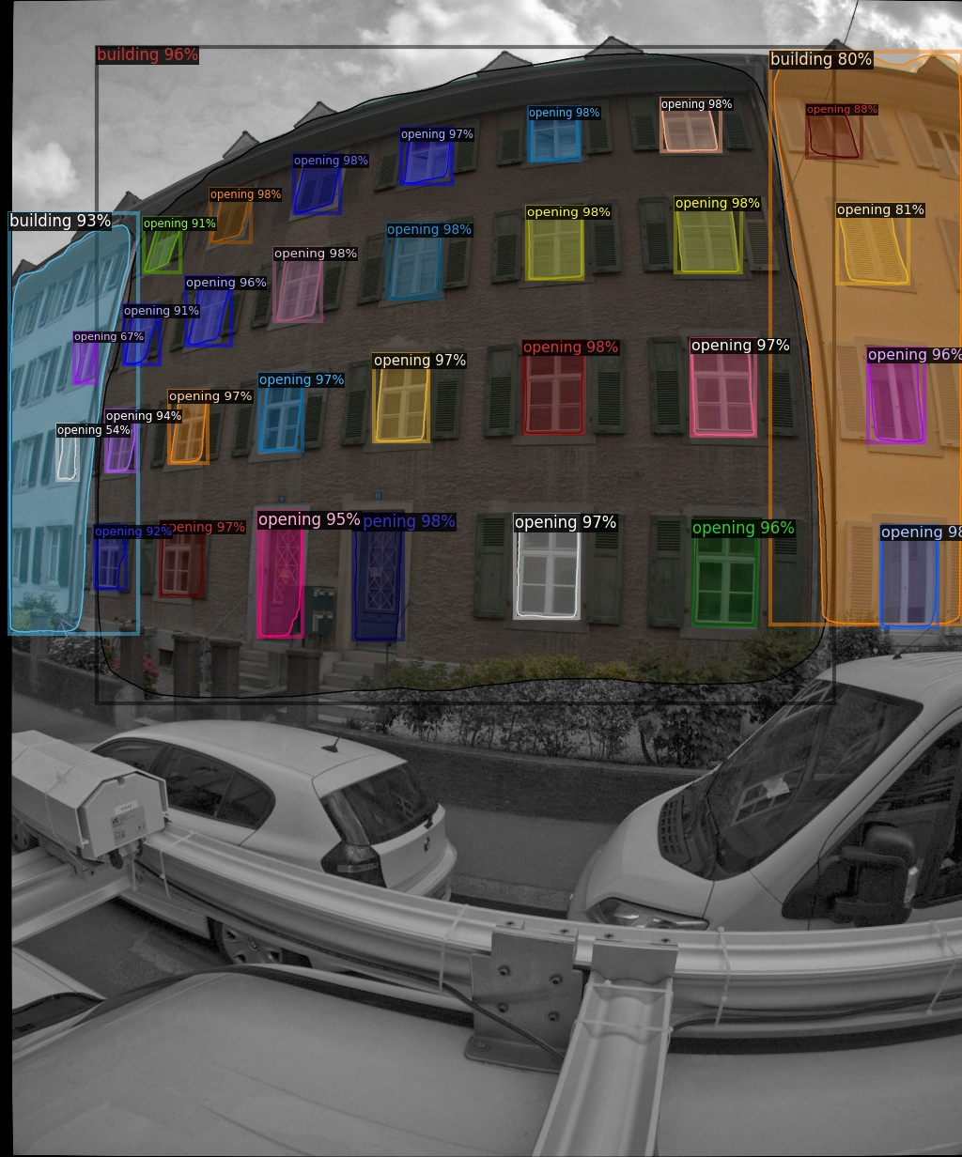
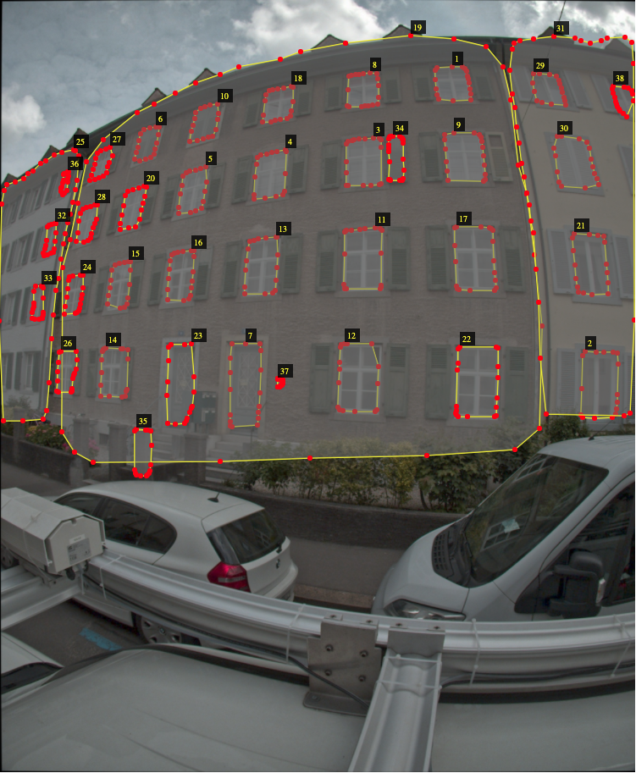
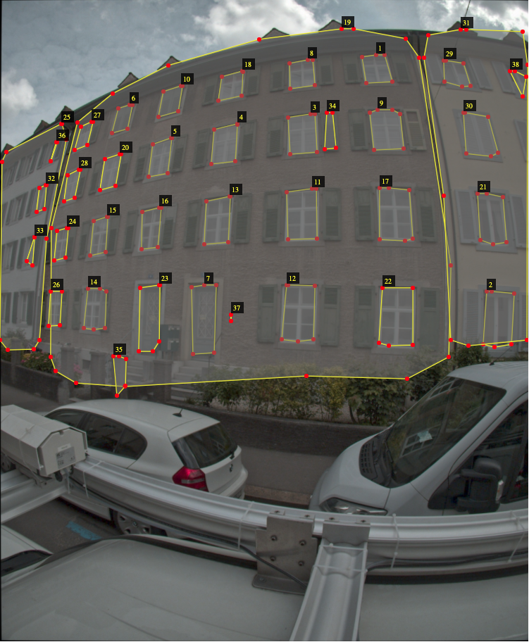
Self-Annotation: Results
Predictions
Polygon conversion
RDP conversion

Slide 12
Experiment Detail

Slide 13
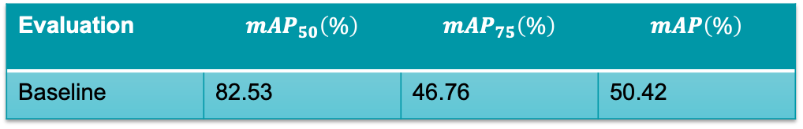
Baseline
Basel dataset: 3644 exploitable images; 18 images for validation
IoU is set at a threshold ( 0.5 for example), if IoU value for a prediction is larger than 0.5, then we classify the prediction as True Positive (TF).
Mean average precision (mAP): mAP is finding the area under the precision-recall curve at certain IoU(intersection over union) threshold.
Fine tuning Mask R-CNN with CityScapes dataset
Baseline: Train Mask R-CNN model with a training batch of 87 images
Evaluation | $$mAP_{50}\left(\%\right)$$ | $$mAP_{75}\left(\%\right)$$ | $$mAP\left(\%\right)$$
Baseline | 82.53 | 46.76 | 50.42

Slide 14
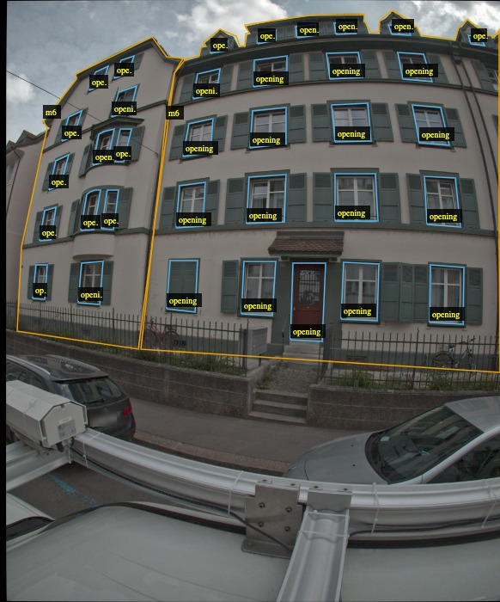
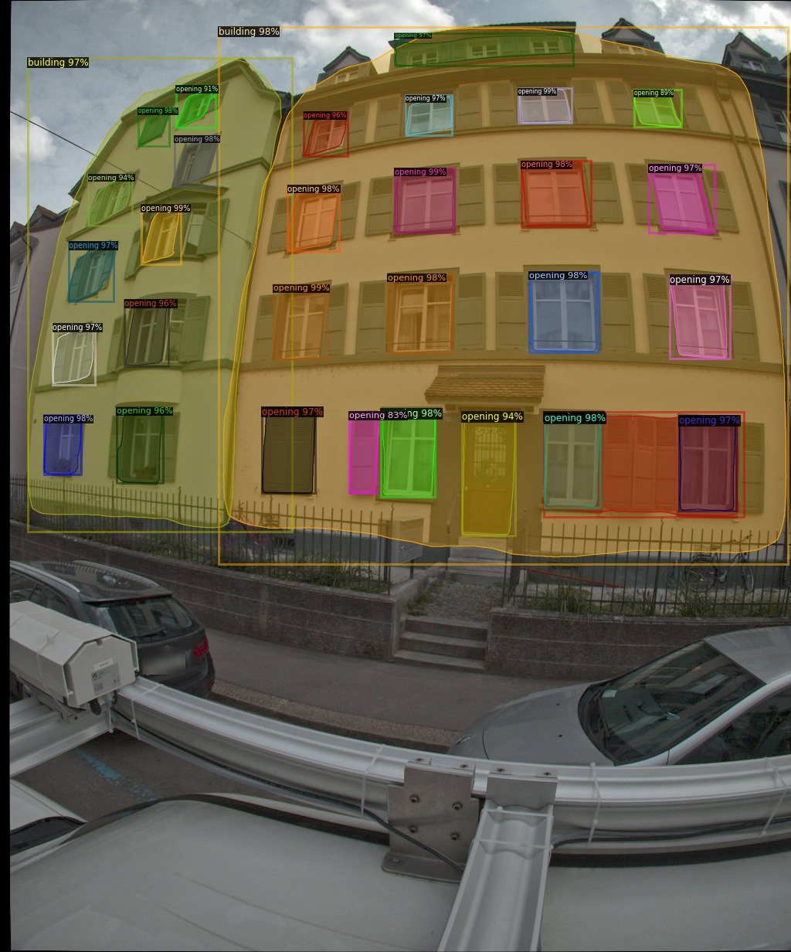
Baseline validation
The model predict the bounding box and boundary mask of opening, and building
The windows, doors, and roof of buildings are nicely predicted
Input image
Predicted image

Slide 15
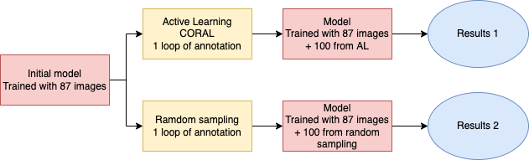
Experiment
Basel dataset
mAP

Slide 16
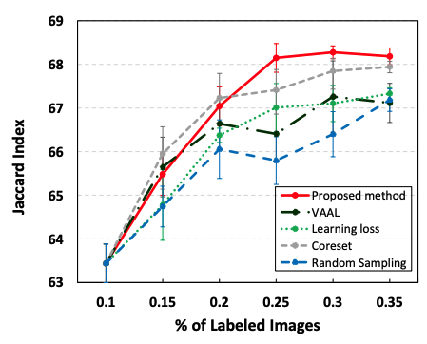
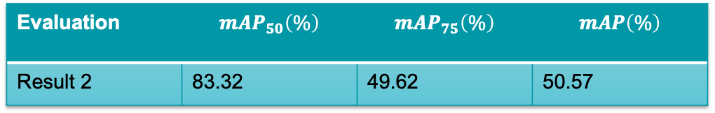
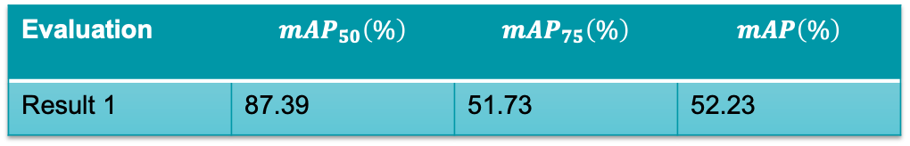
Evaluation
Annotation time reduced by 30% with self-annotations
Results for the first experiment:
Results for the second experiment:
With Active Learning mAP 50 improved by 4.9% and mAP 75 improved by 4.3%
Evaluation | $$mAP_{50}\left(\%\right)$$ | $$mAP_{75}\left(\%\right)$$ | $$mAP\left(\%\right)$$
Result 1 | 87.39 | 51.73 | 52.23
Evaluation | $$mAP_{50}\left(\%\right)$$ | $$mAP_{75}\left(\%\right)$$ | $$mAP\left(\%\right)$$
Result 2 | 83.32 | 49.62 | 50.57
Results from Confident Coreset paper

Slide 17
Conclusion
Active Learning can reduce annotation time by 40%
Self-prediction can reduce annotation time by 30%
Overall we can expect to reduce annotation time by 60%
Finally, with the new annotations we improved the mAP by 7.6%

Slide 18
Thank you for your attention

Slide 19
Appendix

Slide 20
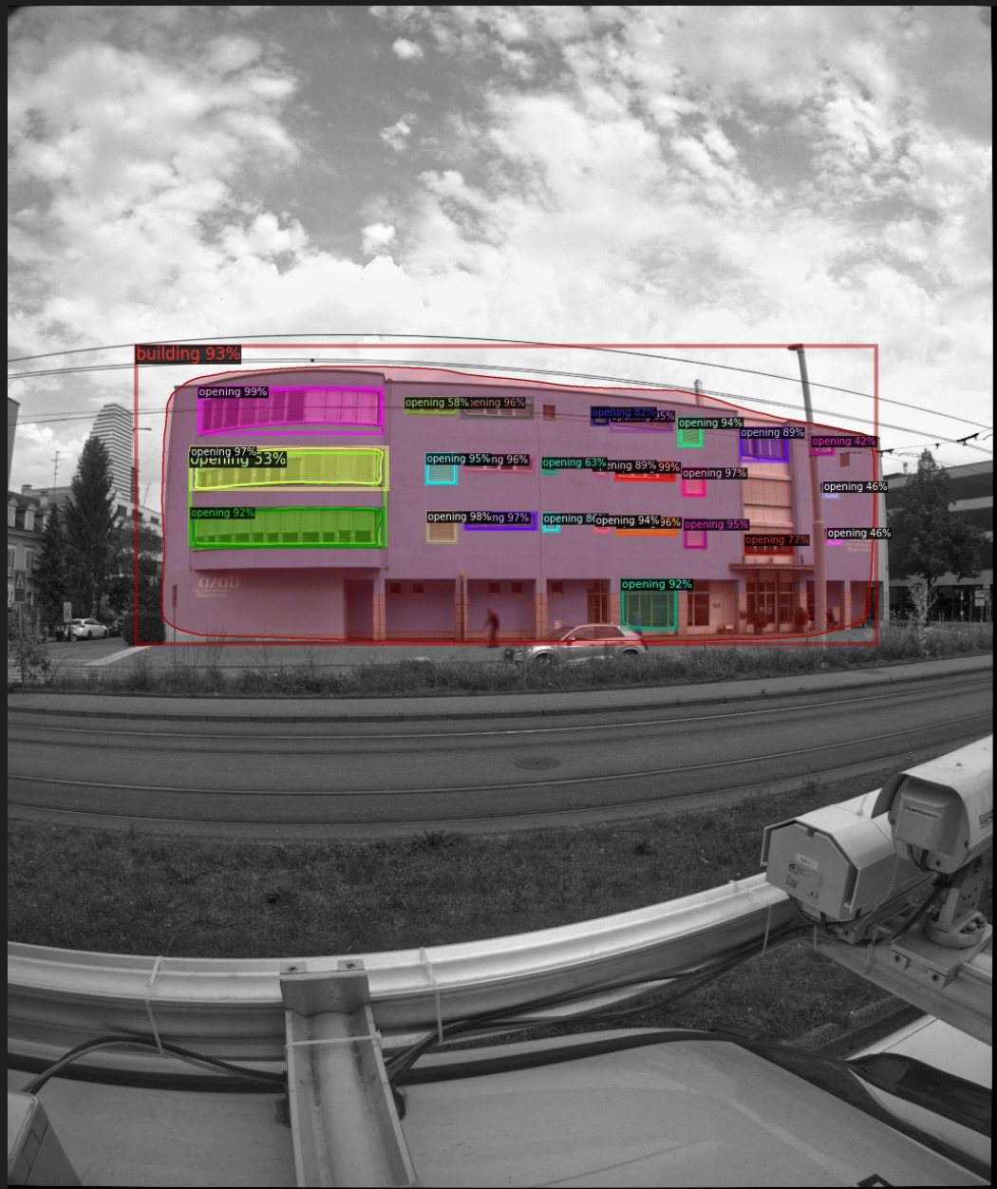
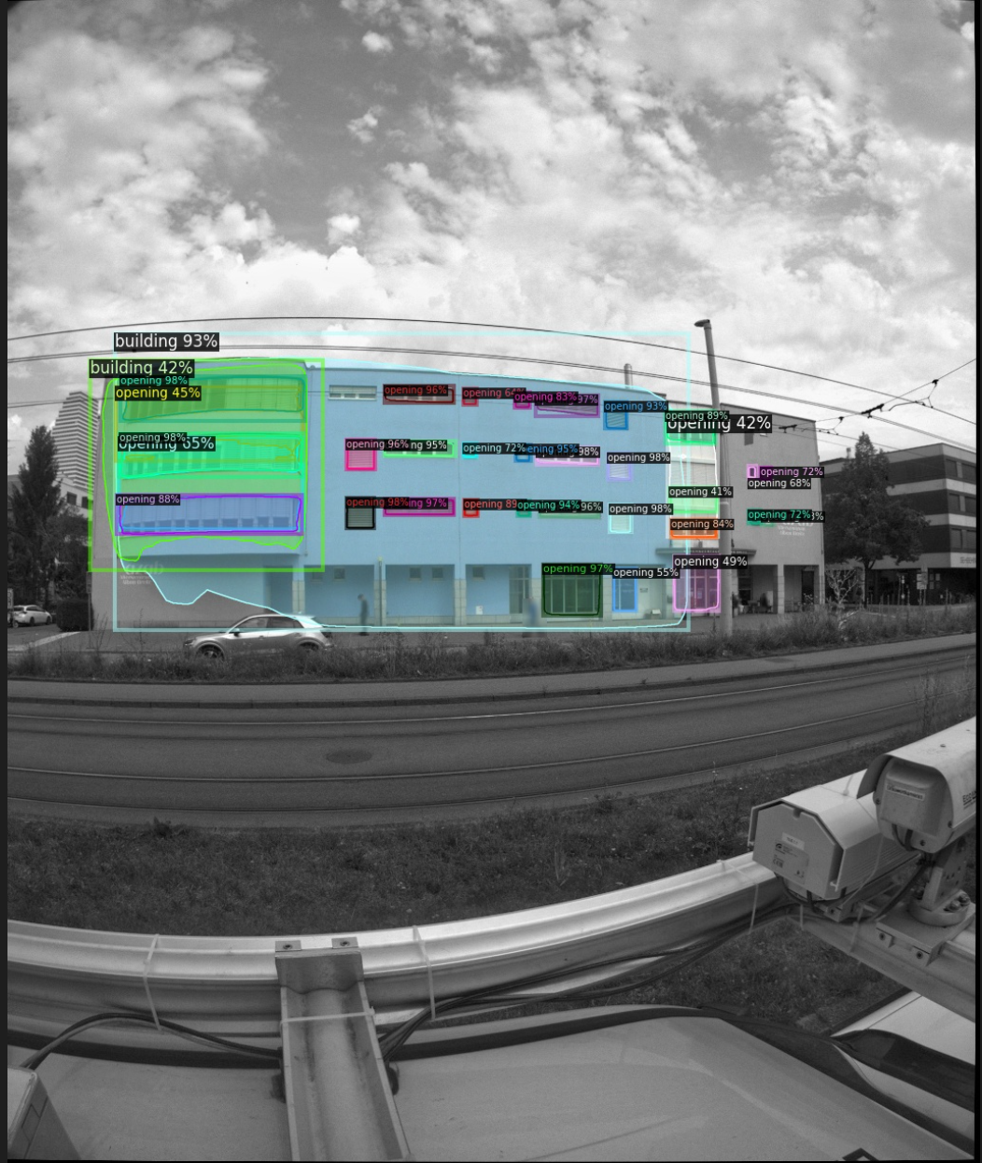
Prediction on the full dataset

Slide 21
Fine tuning
it can help to avoid over-fitting and make the model more robust.
Usually, we fine-tune some higher-level portions of the network. The reason is that the pre-trained model’s earlier layers contain more generic and fundamental features that could be useful to many tasks, but later or deeper layers become more specific to the details of the classes contained in the original dataset.
In our Fine-Tunned Mask RCNN model, we
Use the pre-trained ResNet model training on the CityScapes dataset; The Cityscapes dataset focuses on semantic understanding of urban street scenes. Cityscapes dataset is similar to our dataset since it contains many buildings
2. Keep the parameter of the backbone ResNet, and fine tune the RPN, classifier, and mask heads of the network.

Slide 22
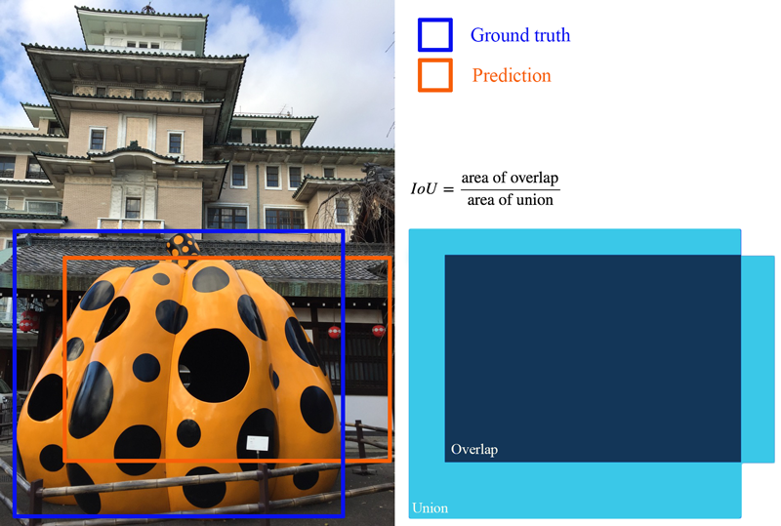
Evaluation
For object detection tasks, we calculate precision and recall using IoU value for a given IoU threshold.
Precision: It measures how many of the predictions that model made were actually correct.
Recall measures how good you find all the positives
For each bounding box, we measure an overlap between the predicted bounding box and the ground truth bounding box. This is measured by IoU (intersection over union)
Notes:
Object detection systems make predictions in terms of a bounding box and a class label.

Slide 23
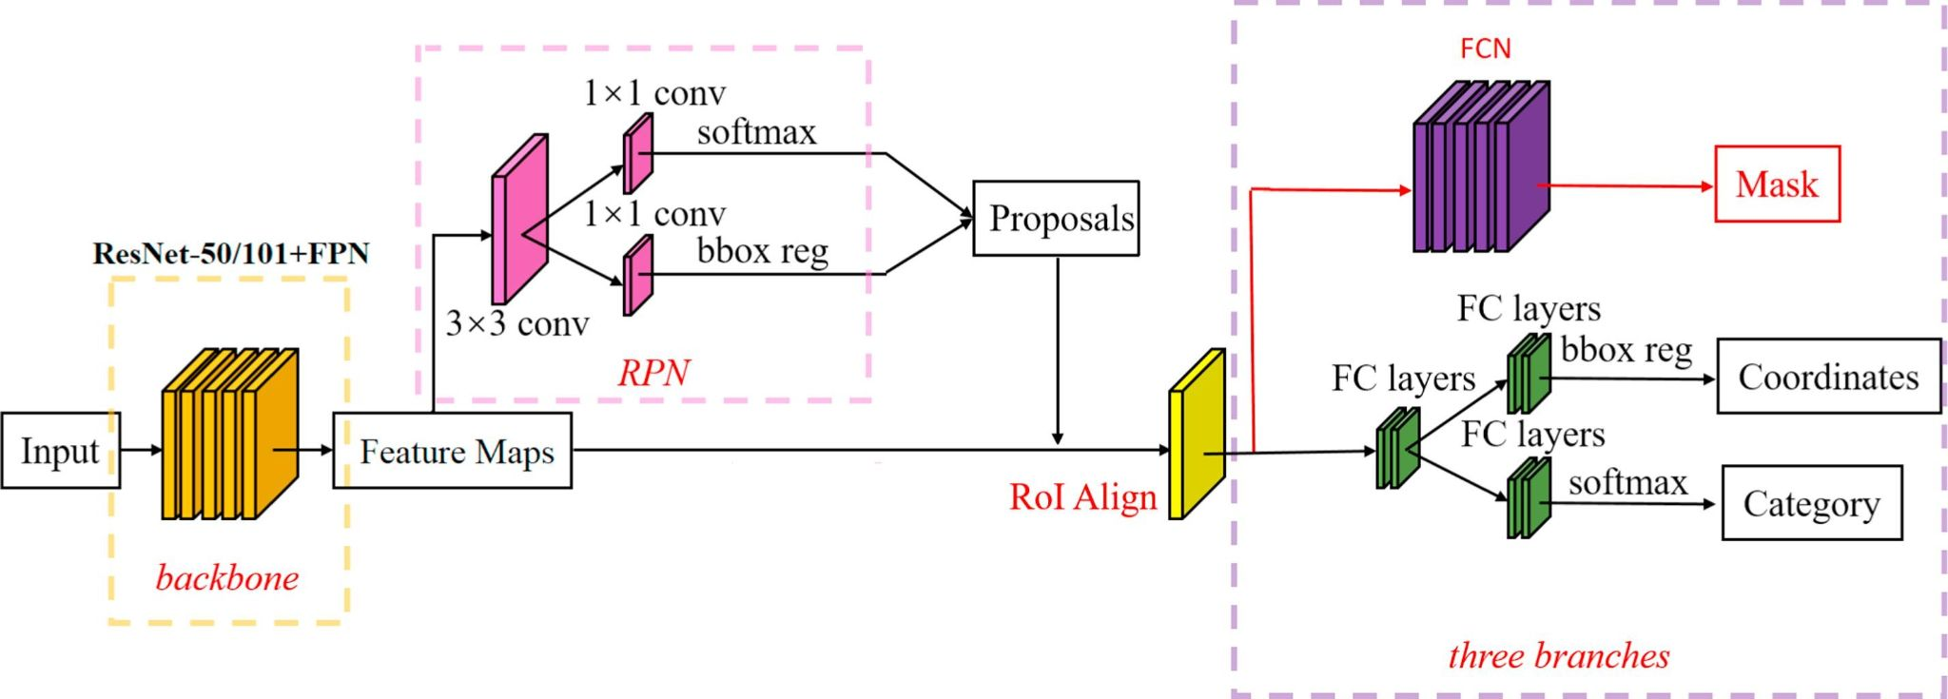
Mask RCNN Framework (3 stages)
The backbone network extracts feature maps from input images.
Feature maps are sent to the region proposal network (RPN) to generate regions of interest(ROIs).
ROIs are mapped to extract the corresponding target features in the shared feature maps, then its output goes to the fully connected (FC) networks for classification, and goes to the fully convolutional network (FCN) for instance segmentation.
Notes:
This process generates the classification scores, bounding boxes and segmentation masks.

Slide 24
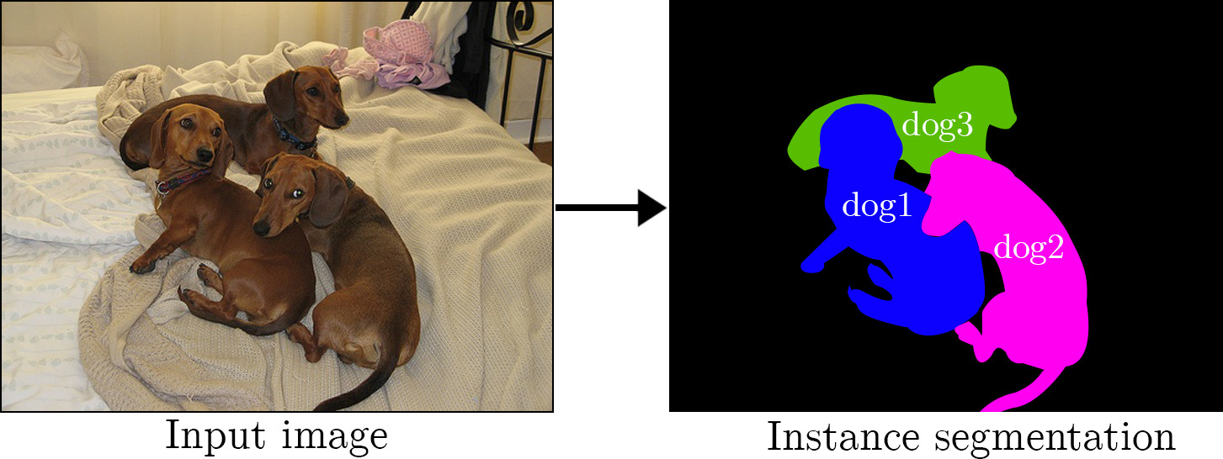
Instance segmentation
Instance segmentation is identifying each different object instance of the same class or category within an image.
Notes:
For example. The dogs in the input image are distinguished into three distinct dogs.

Slide 25
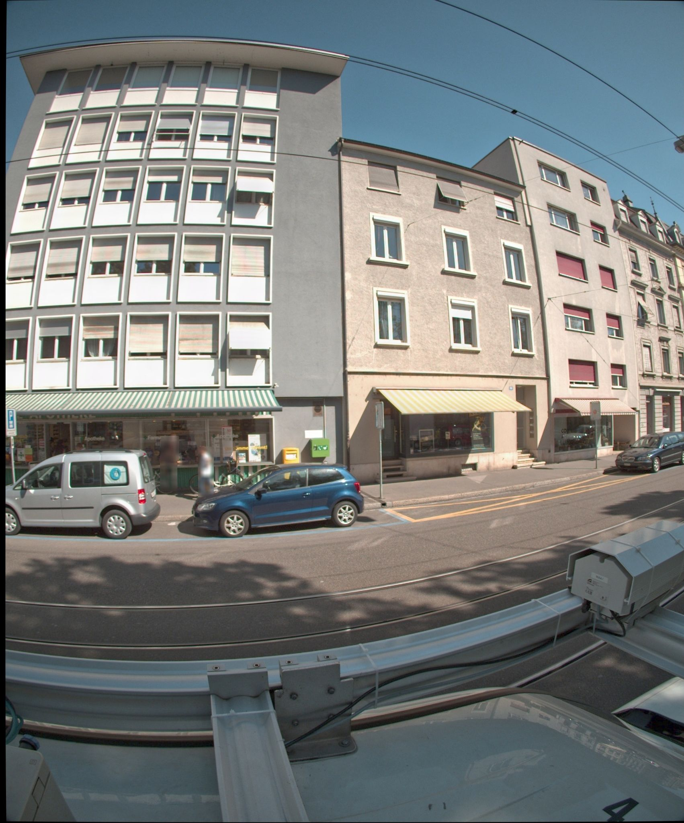
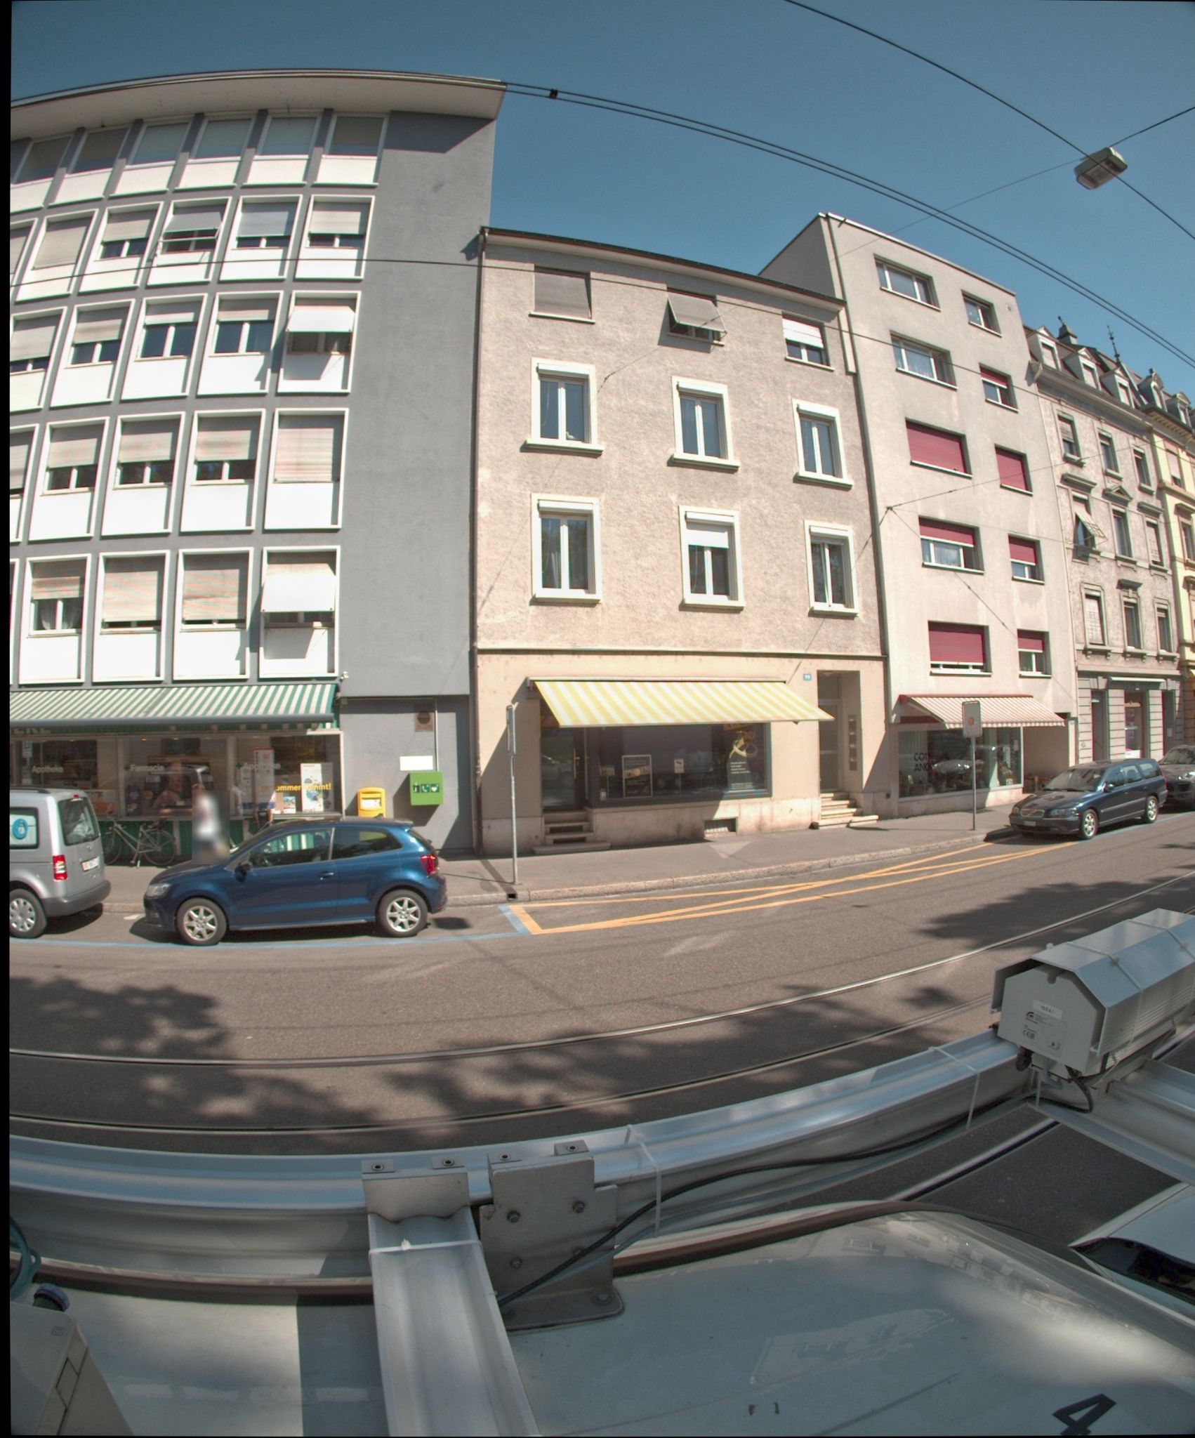
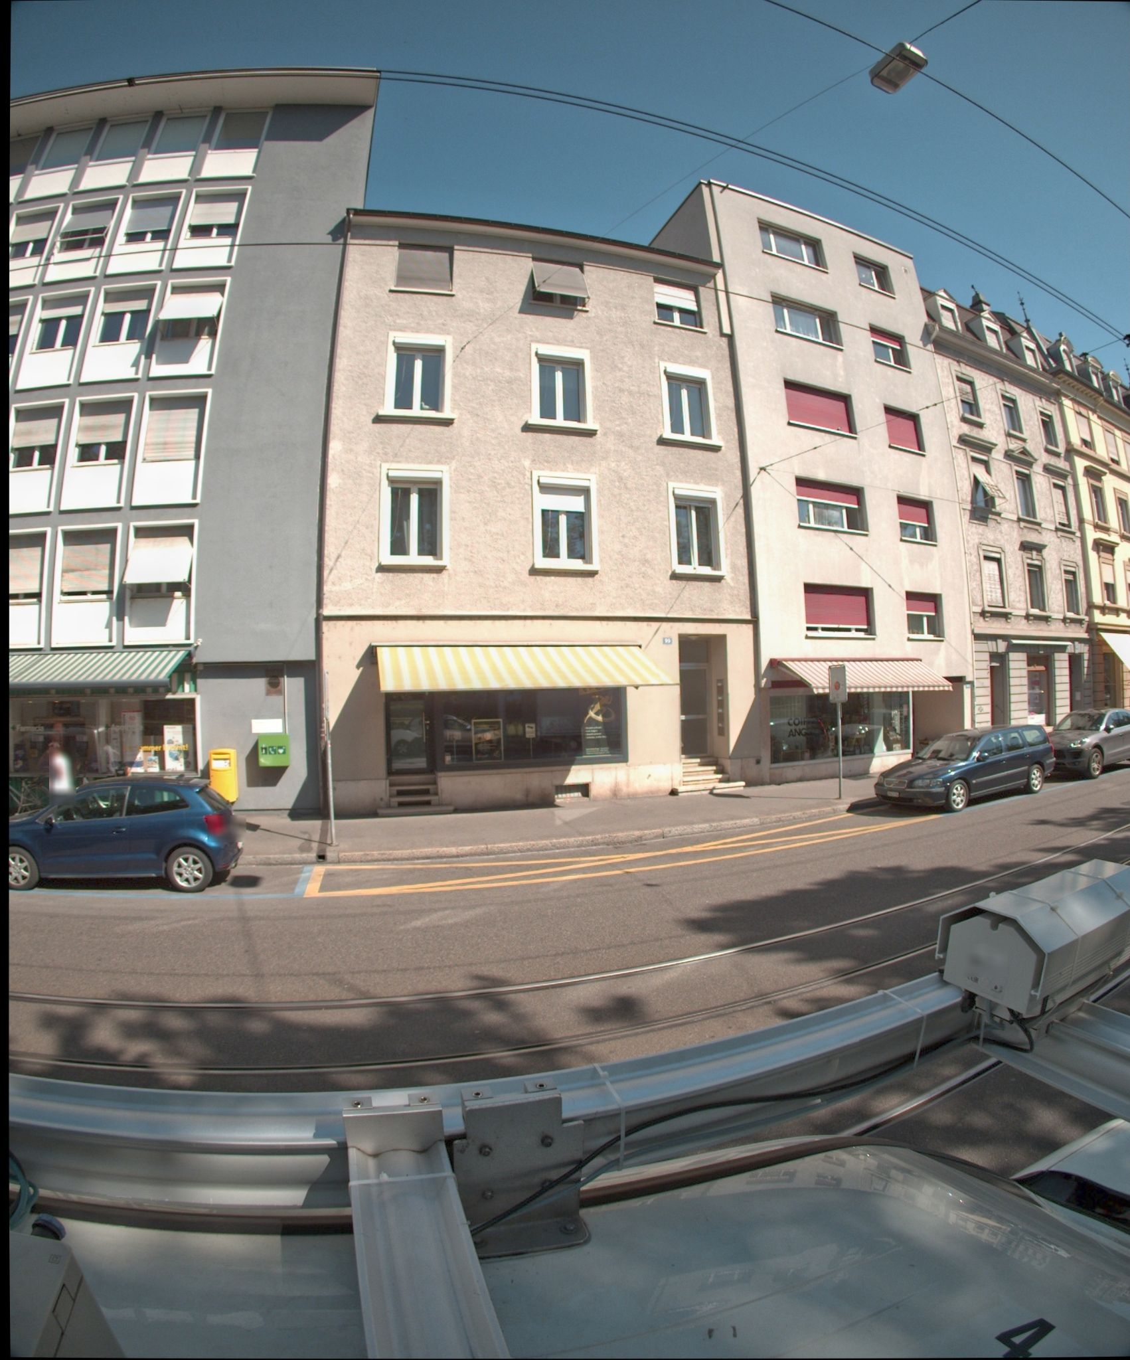
Basel example
Needs: Create statistics, risk assessments etc..
Building image dataset
Street view building images from Basel, taken from a panorama camera
Image frames from one segment
Notes:
This project can help the government know the distribution of buildings and building type ratio，and can be useful for government to do the risk assessment.

Slide 26
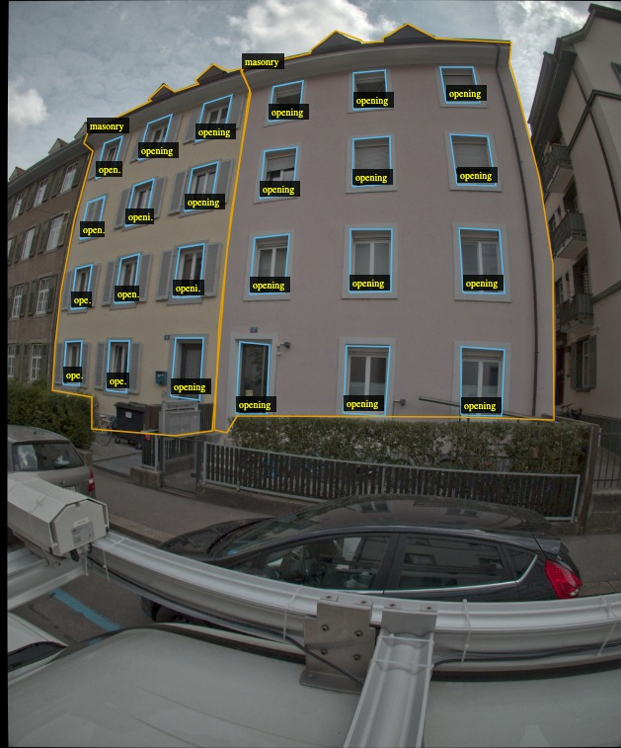
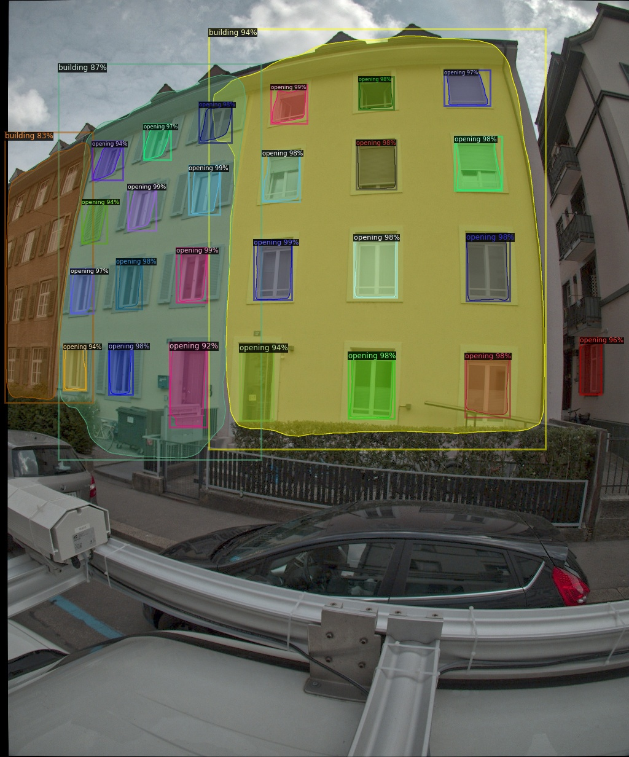
Validation of prediction
Another example
Input image
Predicted image

Slide 27
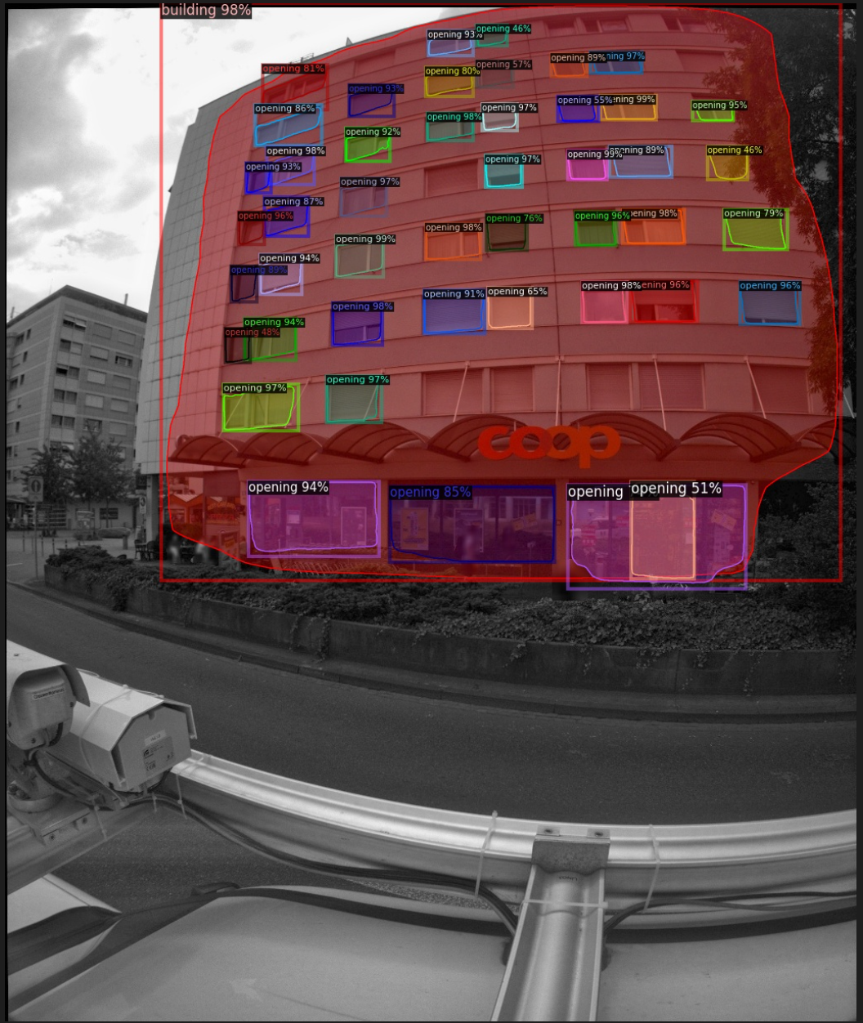
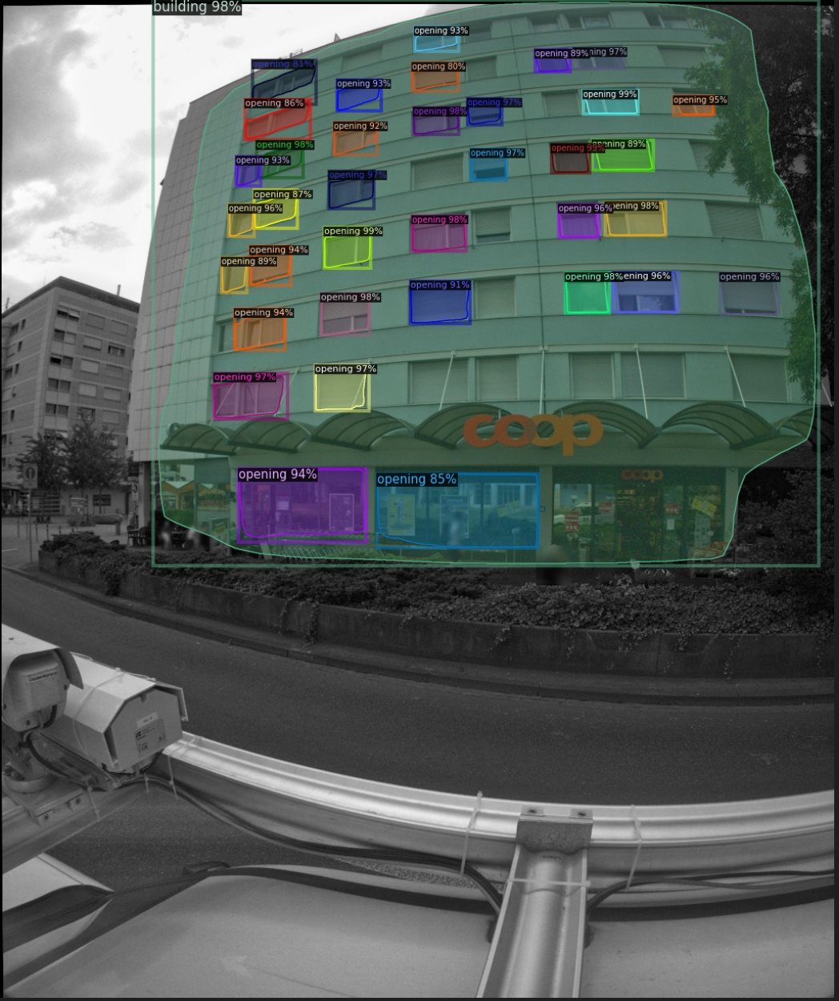
Prediction on the full dataset
ROI head threshold test score = 0.40
ROI head threshold test score = 0.80

Slide 28
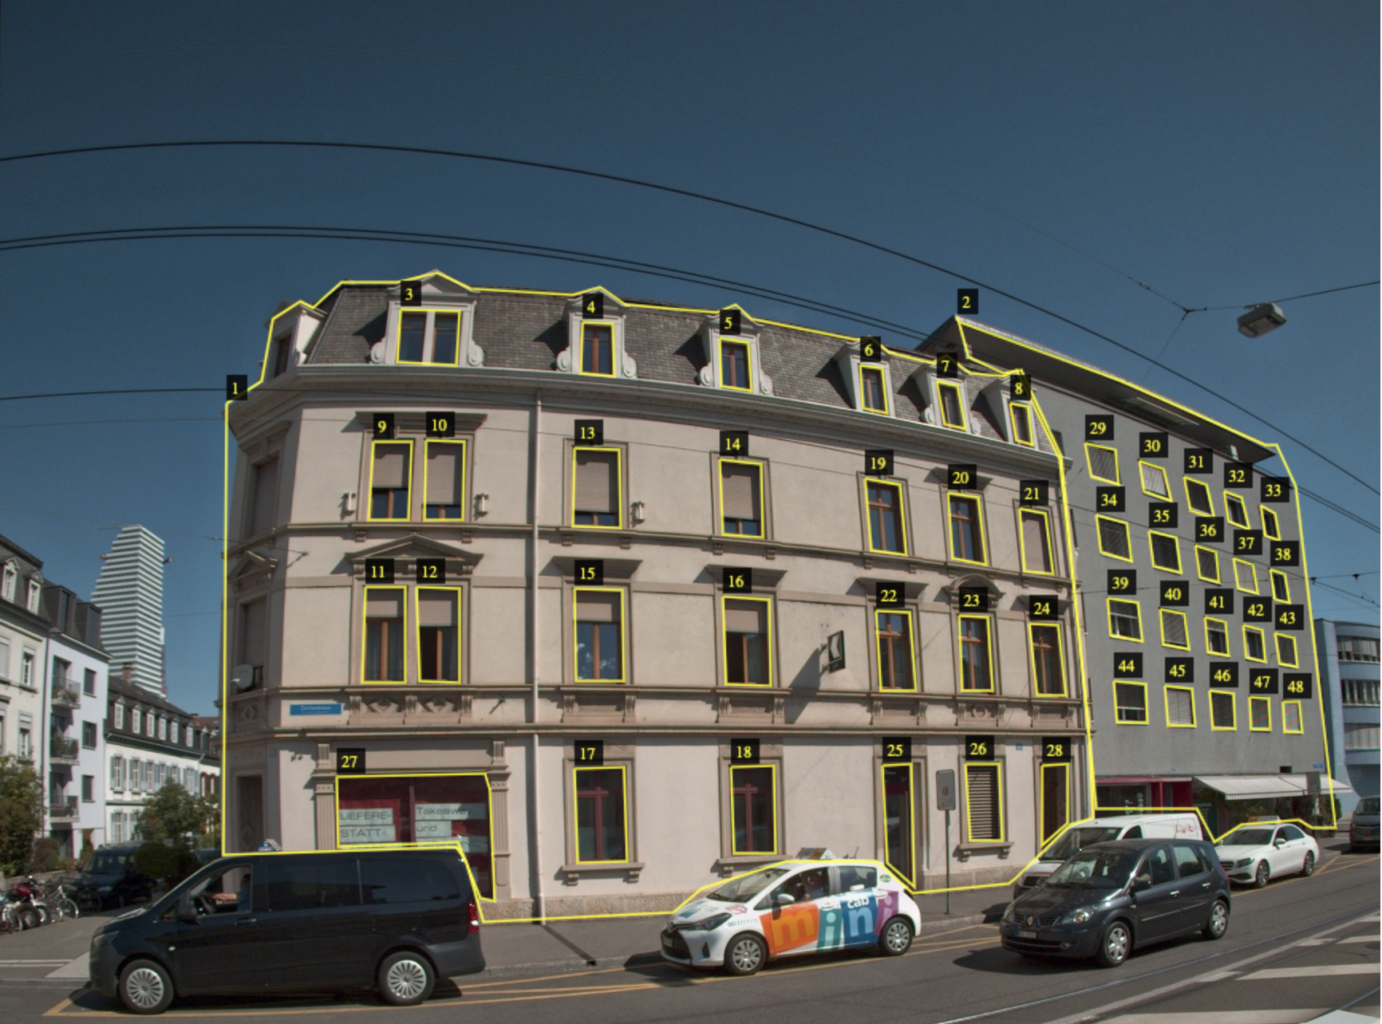
Annotation
Use VGG Image Annotator to annotate images. We have two types of labeling
Annotate ‘building’ and ‘opening’

